Slide 1


H1BVisa- Sentimental Analysis
Instructor : Prof. Eli Kane

Slide 2

Our Team
Akshay Veeramaneni
Roshan Cintury
George Thomas
Arundas Pulickathadathil
Sivadasan

Slide 3
Introduction
With recent changes in the American Visa policies, the sentiment analysis of H1B Visa applications will help us understand its impact on foreign workers, companies and the US economy.

Slide 4
Objectives
To Compare the opposing views of the media for our analysis.
To understand the impact of the changing policy over workers and employers.
To understand the people’s opinion about the changing policies.
To understand if the people like or dislike the policy and built recommendation.

Slide 5
News channel websites
Fox News :
https://www.foxnews.com/politics/businesses-brace-for-trump-decision-on-h-1b-visas-in-wake-of-sessions-pick
The Washington Post:
https://www.washingtonpost.com/graphics/national/visas-impact/

Slide 6
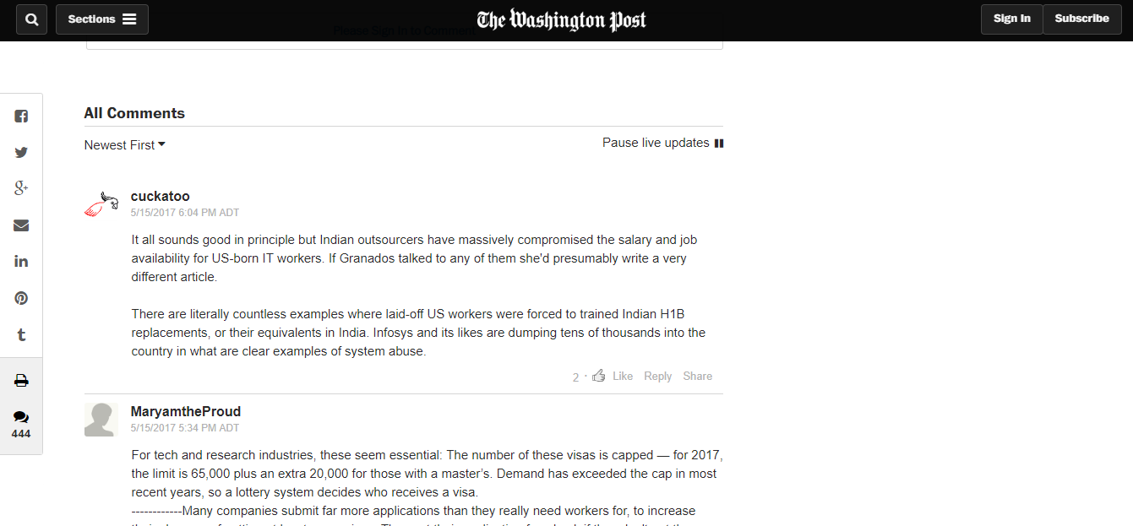
The Washington Post:

Slide 7
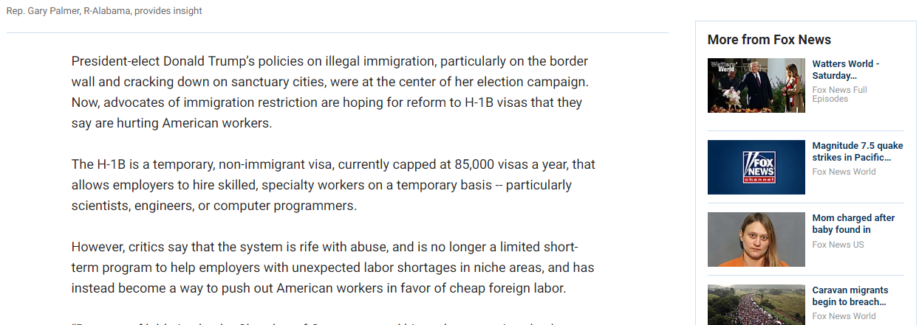
FOX news:

Slide 8
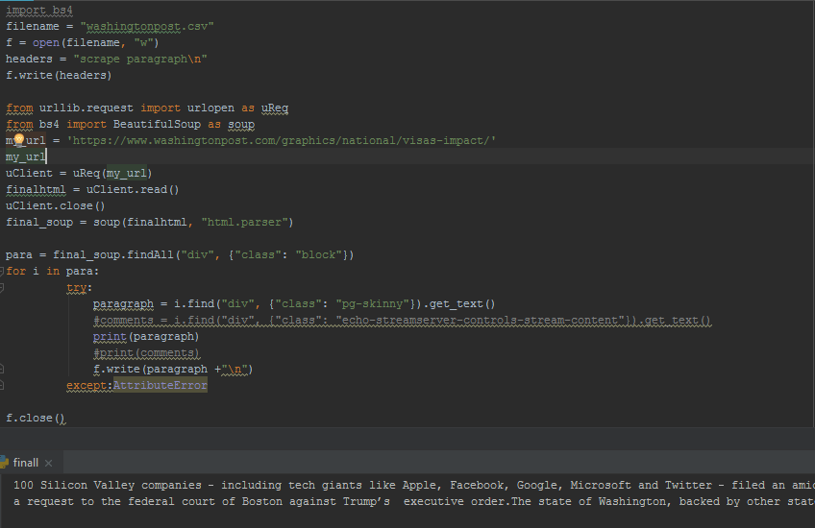
Web Scraping:

Slide 9
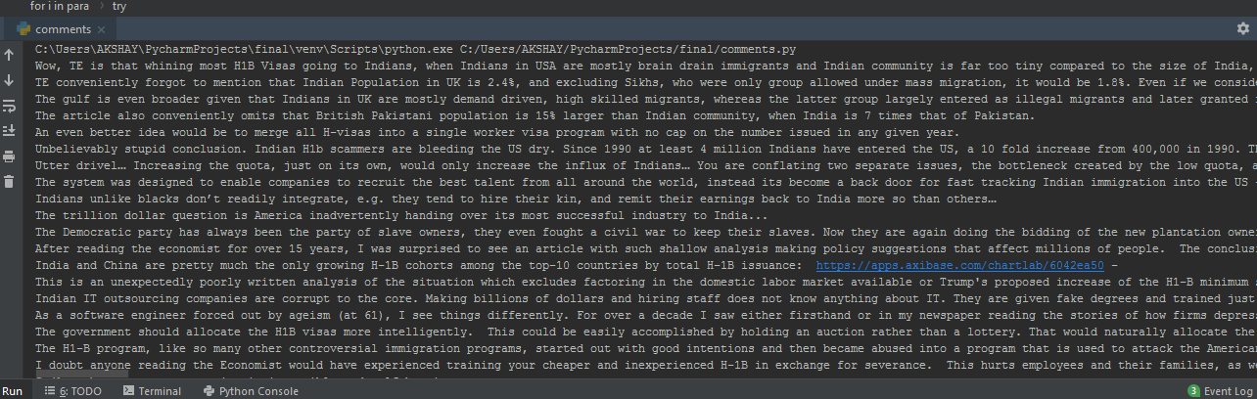
Web Scraping:

Slide 10
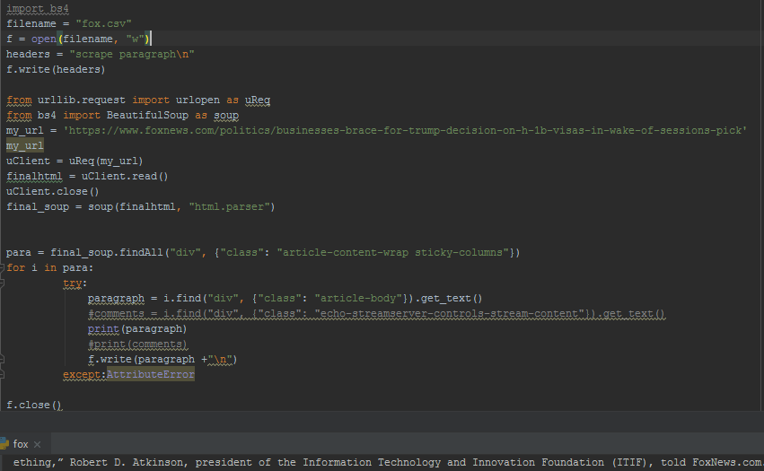
Web Scraping:

Slide 11
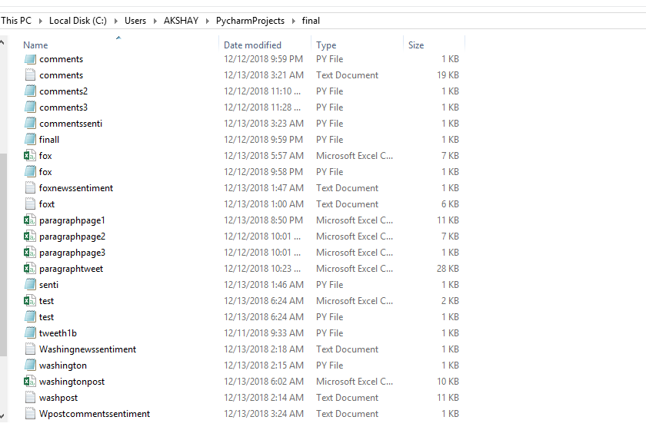
Scrapped data files:

Slide 12
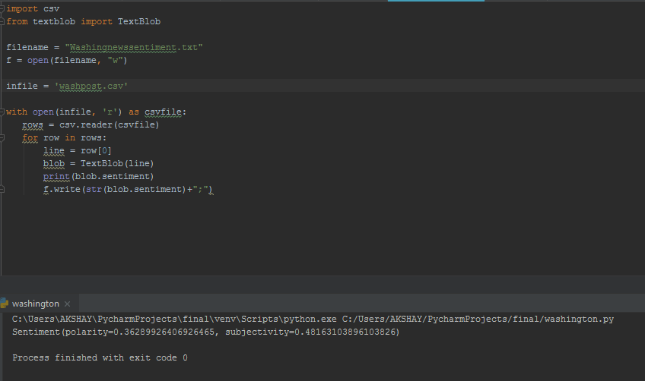
Sentiment Analysis:

Slide 13
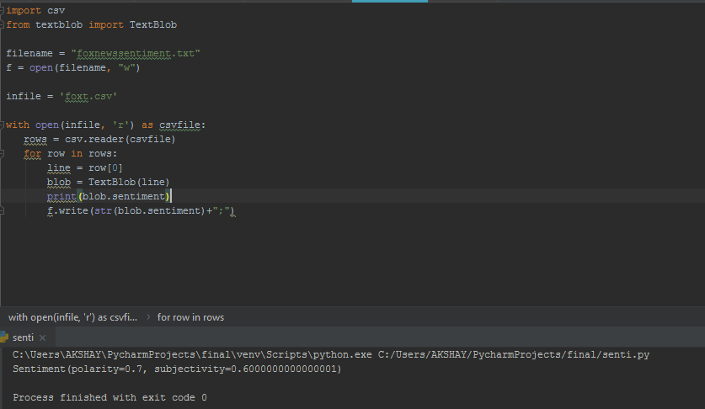
Sentiment Analysis:

Slide 14
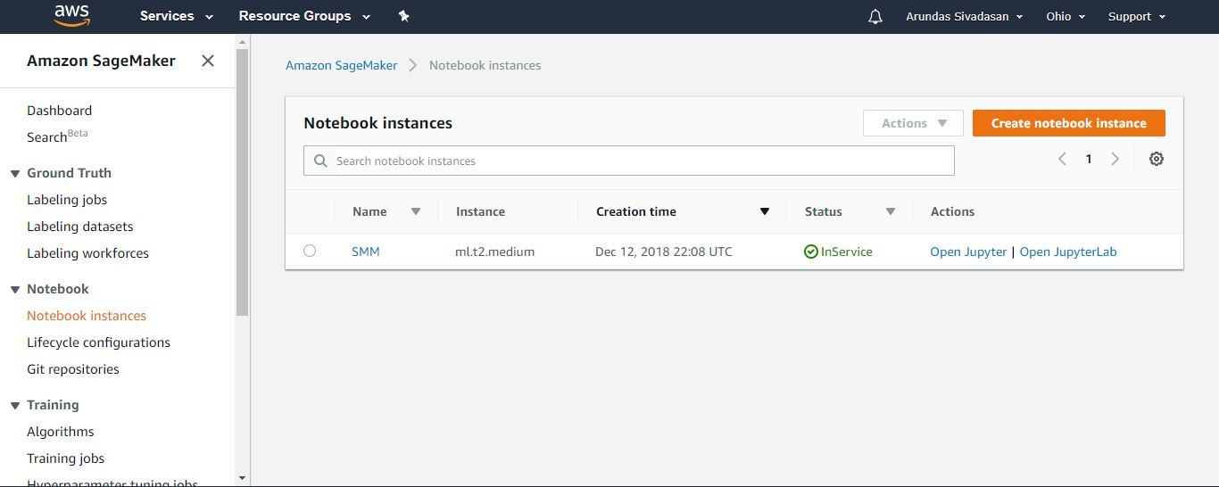
Sentiment Analysis:

Slide 15
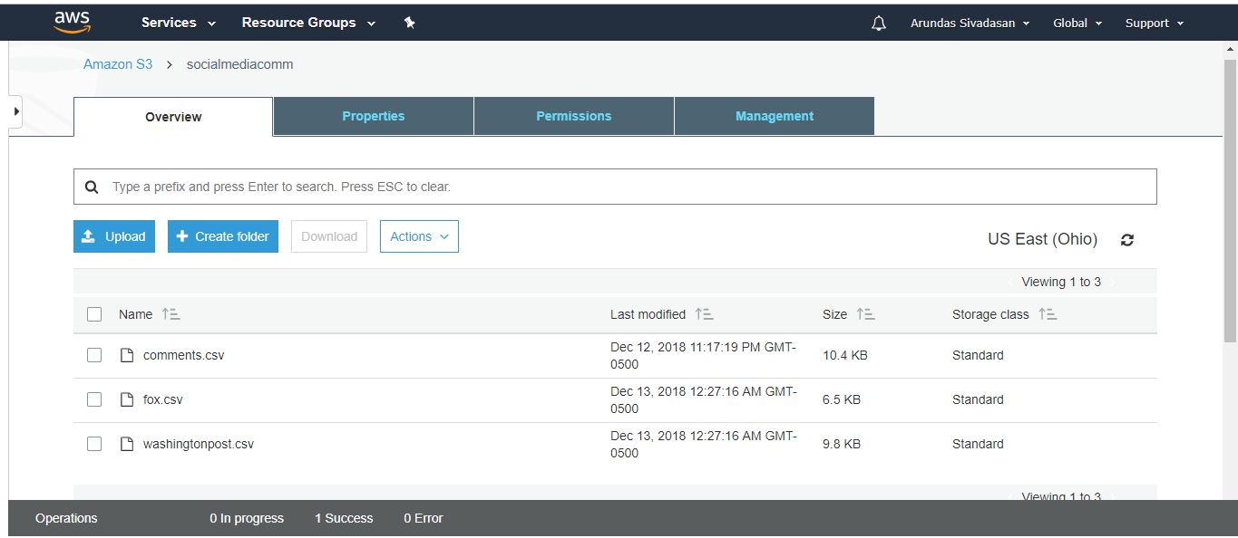
Storing data in AWS S3 bucket:

Slide 16
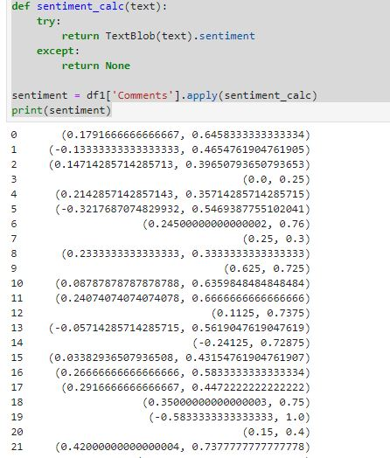
Sentiment Analysis in Jupiter Notebook Inst:

Slide 17
DATA VISUALIZATION: http://www.akshaywebsite/SDMhtmlfile SHAREPOINT LINK: https://georgiancollege.sharepoint.com/sites/finalassignmentsentimentanalysis/final%20assignment%20files/Forms/AllItems.aspx

